Slide 1
CIND820 Big Data Analytics Capstone Project A study of developing a Movie Recommendation System using different Machine Learning Algorithms.
Shahin Ahmed
Student # 500995601

Slide 2
Outline Introduction Problem Statement Dataset Recommendation Model Building Validation and Comparisons Conclusions and Future Work

Slide 3
Introduction COVID-19 changes the people lifestyle, due to the lockdown at home, the internet usages are increased, and it impacts on the social life. According to Forbes the initial internet hits increased by between 50% and 70%. Entertainment sites like Netflix, Facebook usages also jumped by 12% approximately. Considering these changes, Recommendation systems are becoming particularly important in media industry as well as online consumer world. People always prefer to see the items/movies based on their previous search into the system. My project will focus on develop the recommendation system which will help individual to search for content that would be interesting to him/her based on algorithms that sort out all possible choices and create a customize lists of items for that individual.
Introduction Problem Statement Dataset Building Recommendation Model Validation and Comparisons Conclusions and Future Work

Slide 4
Introduction cont.
Introduction Problem Statement Dataset Building Recommendation Model Validation and Comparisons Conclusions and Future Work
Recommender systems usually generate recommendations to users, in one of the following ways:
- Collaborative filtering algorithms [3] predict items/products for an active user based on the past data about the other users for same items/products.
- Content-based algorithms [4] creates recommendations based on items/products descriptions which could be automatically extracted or manually created, or (and) from user profile which reflects user’s interests on that items/products.
- Knowledge-based algorithms [5] predicts a recommender system based on specific queries made by the user. It might prompt the user to give a series of rules or guidelines on what the results should look like, or an example of an item. The system then searches through its database of items and returns similar results.
- Hybrid approaches [6] generate recommendations by combining several algorithms or recommendation components, which are based on the above three approaches: collaborative filtering and content-based and knowledge-based algorithms.

Slide 5
Problem Statement The goal of this project is to give a better understanding of User Based Collaborative Filter (UBCF) and Item Based Collaborative Filter (IBCF) models for a recommender systems by answering the following question: With what level of performance can collaborative filtering using UBCF and IBCF models produce movie recommendations based on movies and user’s ratings data? The project will be developed using the R tools.
Introduction Problem Statement Dataset Building Recommendation Model Validation and Comparisons Conclusions and Future Work

Slide 6
Dataset The dataset used was from MovieLens, and is publicly available at MovieLens Latest Datasets. In order to keep the recommender simple, I used the smallest dataset available (ml-latest-small.zip), which at the time of download contained 105339 ratings and 6138 tag applications across 10329 movies. These data were created by 668 users between April 03, 1996 and January09, 2016. This dataset was generated on January 11, 2016. The data are contained in four files: links.csv, movies.csv, ratings.csv and tags.csv. I am going to use the files movies.csv and ratings.csv to build a recommendation system. glimpse(movies) ## Rows: 9,742 ## Columns: 3 ## $ movieId <int> 1, 2, 3, 4, 5, 6, 7, 8, 9, 10, 11, 12, 13, 14, 15, 16,... ## $ title <fct> "Toy Story (1995)", "Jumanji (1995)", "Grumpier Old Me... ## $ genres <fct> Adventure|Animation|Children|Comedy|Fantasy, Adventure...
Introduction Problem Statement Dataset Building Recommendation Model Validation and Comparisons Conclusions and Future Work
glimpse(ratings)
## Rows: 100,836
## Columns: 4
## $ userId <int> 1, 1, 1, 1, 1, 1, 1, 1, 1, 1, 1, 1, 1, 1, 1, 1, 1, 1...
## $ movieId <int> 1, 3, 6, 47, 50, 70, 101, 110, 151, 157, 163, 216, 2...
## $ rating <dbl> 4, 4, 4, 5, 5, 3, 5, 4, 5, 5, 5, 5, 3, 5, 4, 5, 3, 3...
## $ timestamp <int> 964982703, 964981247, 964982224, 964983815, 96498293...

Slide 7
Building Recommendation Model
Introduction Problem Statement Dataset Building Recommendation Model Validation and Comparisons Conclusions and Future Work
UBCF Model:
Now, I will use the user-based approach. According to this approach, given a new user, its similar users are first identified. Then, the top-rated items rated by similar users are recommended.
For each new user, these are the steps:
Measure how similar each user is to the new one, popular similarity measures are correlation and cosine.
Identify the most similar users. The options are:
Take account of the top k users (k-nearest_neighbors)
Take account of the users whose similarity is above a defined threshold
3. Rate the movies rated by the most similar users. The rating is the average rating among similar users and the approaches are:
Average rating
Weighted average rating, using the similarities as weights
4. Pick the top-rated movies.
IBCF Model
Collaborative filtering is a branch of recommendation that takes account of the information about different users. The word “collaborative” refers to the fact that users collaborate with each other to recommend items. In fact, the algorithms take account of user ratings and preferences.
The starting point is a rating matrix in which rows correspond to users and columns correspond to items. The core algorithm is based on these steps:
For each two items, measure how similar they are in terms of having received similar ratings by similar users
For each item, identify the k most similar items
3. For each user, identify the items that are most similar to the user’s purchases

Slide 8
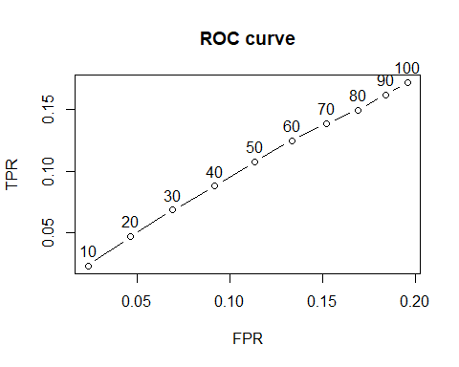
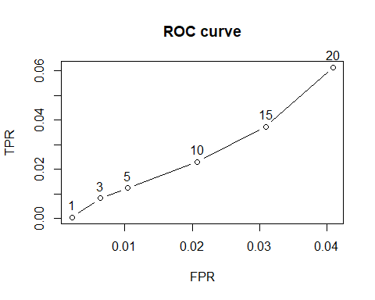
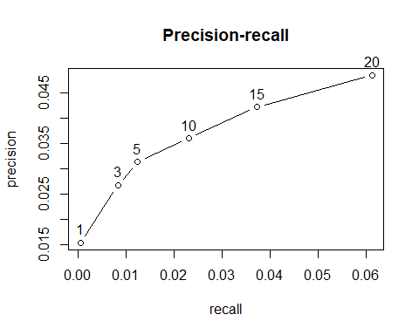
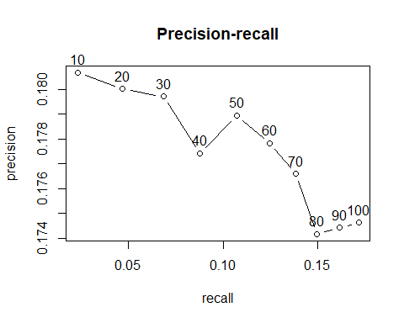
Validation and Comparisons
Introduction Problem Statement Dataset Building Recommendation Model Validation and Comparisons Conclusions and Future Work
Model | RMSE
IBCF | 1.340759
UBCF | 1.105401
UBCF
IBCF

Slide 9
Validation and Comparisons
Introduction Problem Statement Dataset Building Recommendation Model Validation and Comparisons Conclusions and Future Work
Comparing different models
We evaluate UBCF and IBCD model, but multiple models can be evaluated and their performance compared. AUC is our benchmark statistic. In order to compare different models, I define them as a following list:
Item-based collaborative filtering, using the Cosine as the distance function
Item-based collaborative filtering, using the Pearson correlation as the distance function
User-based collaborative filtering, using the Cosine as the distance function
User-based collaborative filtering, using the Pearson correlation as the distance function
SVD or Matrix Factorization
Random recommendations to have a base line

Slide 10
Validation and Comparisons
Introduction Problem Statement Dataset Building Recommendation Model Validation and Comparisons Conclusions and Future Work
Comparing Different Models With Varying Values Of Recommendation (RMSE)
Model | RMSE
IBCF_cos | 1.297885
IBCF_cor | 1.233386
UBCF_cos | 1.047406
UBCF_cor | 0.983980
SVD | 1.007860
Random | 1.289798

Slide 11
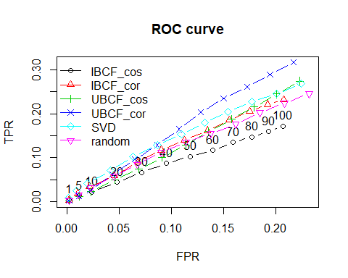
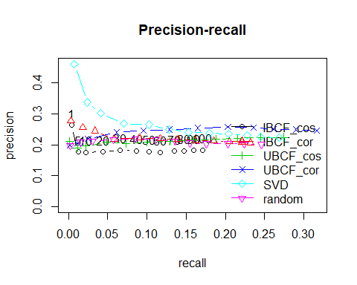
Validation and Comparisons
Introduction Problem Statement Dataset Building Recommendation Model Validation and Comparisons Conclusions and Future Work
Compare the models by building a chart displaying their ROC curves and Precision/recall curves.

Slide 12
Conclusions and Future Work
Introduction Problem Statement Dataset Building Recommendation Model Validation and Comparisons Conclusions and Future Work
In this project, I have developed and evaluated a collaborative filtering recommender (CFR) system for recommending movies. Several models were compared on a reduced dataset. The two top models (SVD & UBCF) were selected to give recommendations on my personal ratings. We see that the best performing model is built by using UBCF and the Pearson correlation as a similarity measure. The model consistently achieves the highest true positive rate for the various false-positive rates and thus delivers the most relevant recommendations.
Let us discuss the strengths and weaknesses of the User-based Collaborative Filtering approach in general.
Strengths:
User-based Collaborative Filtering gives recommendations that can be complements to the item the user was interacting with. This might be a stronger recommendation than what a item-based recommender can provide as users might not be looking for direct substitutes to a movie they had just viewed or previously watched.
Weaknesses:
User-based Collaborative Filtering is a type of Memory-based Collaborative Filtering that uses all user data in the database to create recommendations. Comparing the pairwise correlation of every user in your dataset is not scalable. If there were millions of users, this computation would be very time consuming. Possible ways to get around this would be to implement some form of dimensionality reduction, such as Principal Component Analysis, or to use a model-based algorithm instead. Also, user-based collaborative filtering relies on past user choices to make future recommendations. The implications of this is that it assumes that a user’s taste and preference remain constant over time, which might not be true and makes it difficult to pre-compute user similarities offline.
Future Work:
This report briefly describes simple models that predicts ratings. There are two others widely adopted approaches not discussed here: Content-based Models and collaborative filtering Matrix Factorization Models. The recommenderlab package implements these methods and provides an environment to build and test recommendation systems. Also, I’m planning to develop a web recommendation systems using Shiny package in R to see the practical use of my project.

Slide 13
Q & A

Slide 14
Thanks!

